Slide 1
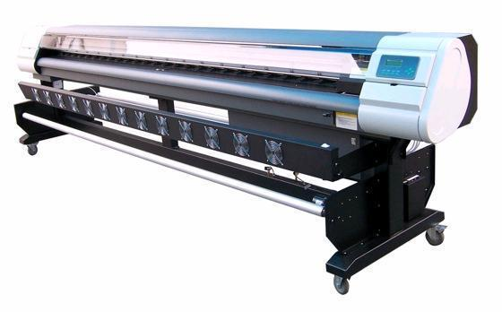
Printing and Translating Files
Presenter
Developer Technical Services

Slide 2
Agenda
PrintManager Object
DrawingPrintManager
Printing Example
File Translation
Accessing Translators Options
DataIO Object

Slide 3
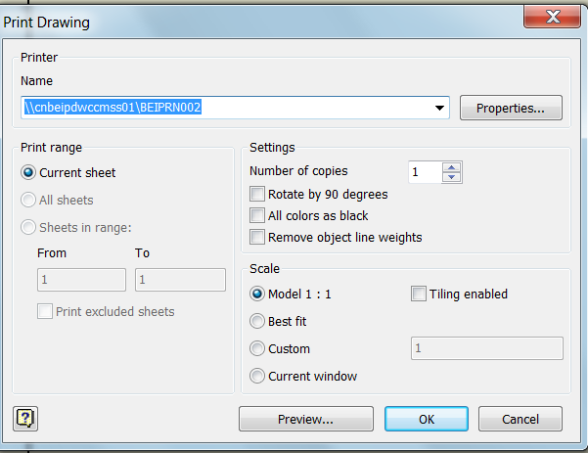
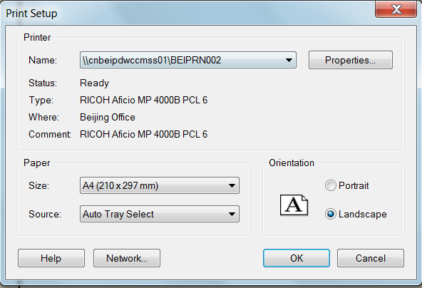
Printing
The PrintManager object is accessed from the various documents.
Drawings and Apprentice support special print managers that provide additional printing capabilities.
The PrintManager objects provide that same settings that are available in the Print command dialogs.

Slide 4
PrintManager - Main Properties
NumberOfCopies: Default value to 1
PaperHeight / PaperWidth: sets the paper dimensions. This property is only used when the PaperSize property is set to kPaperSizeCustom
Printer: gets and sets the name of the printing device
PrintToFile(String FileName): prints to the specified file using the current property settings
SubmitPrint: prints using the current property settings

Slide 5
DrawingPrintManager
The DrawingPrintManager object derives from PrintManager and has some additional properties and methods specific to drawing documents:
AllColorsAsBlack
PrintRange: can be set to kPrintCurrentSheet, kPrintAllSheets, kPrintSheetRange.
ScaleMode / Scale : gets and sets how the scale of the print is defined.
RemoveLineWeights
GetSheetRange / SetSheetRange: gets/sets the sheet range to print.

Slide 6
Printing - Example
Make sure you set the printer first. This resets all other options to the default values for that printer.
Public Sub PrintSample()
Dim oDrawDoc As DrawingDocument
oDrawDoc = _InvApplication.ActiveDocument
Dim oPrintMgr As DrawingPrintManager
oPrintMgr = oDrawDoc.PrintManager
With oPrintMgr
.Printer = \\ADSOREPS1\oreprn001
.NumberOfCopies = 1
.ScaleMode = PrintScaleModeEnum.kPrintFullScale
.PaperSize = PaperSizeEnum.kPaperSize11x17
.SubmitPrint()
End With
End Sub

Slide 7
File Translation
Simple Translation
Use the Document.SaveAs and Documents.Open methods to translate documents in and out of Inventor.
Inventor uses the extension of the filename supplied to determine which translator to use.
Default settings are used. The default settings are the settings last used when interactively translating a file.
Documents.Open( “C:\Temp\Test.stp” )
Document.SaveAs( “C:\Temp\New.dwg”, True )

Slide 8
File Translation
Most Inventor translators are implemented as Translator Add-Ins.
You can access and drive the translator directly through the translator Add-In’s interface.
API Allows control of the translator’s various options.

Slide 9
Accessing Translator’s Open Options
Public Sub GetTranslatorOpenOptions()
Dim clsId As String
clsId = "{90AF7F40-0C01-11D5-8E83-0010B541CD80}" 'Ex STEP Translator
Dim oTranslator As TranslatorAddIn
oTranslator = _InvApplication.ApplicationAddIns.ItemById(clsId)
Dim medium As DataMedium
medium = _InvApplication.TransientObjects.CreateDataMedium
medium.FileName = "C:\Temp\MyInventorDoc.xxx"
medium.MediumType = MediumTypeEnum.kFileNameMedium
Dim context As TranslationContext
context = _InvApplication.TransientObjects.CreateTranslationContext
Dim options As NameValueMap
options = _InvApplication.TransientObjects.CreateNameValueMap
Dim index As Integer
If oTranslator.HasOpenOptions(medium, context, options) Then
For index = 1 To options.Count
Debug.Print(options.Name(index) & " = " & options.Value(options.Name(index)))
Next
End If
End Sub

Slide 10
Accessing Translator’s Save Options
Public Sub GetTranslatorSaveAsOptions()
Dim clsId As String
clsId = "{0AC6FD95-2F4D-42CE-8BE0-8AEA580399E4}" ' Ex DWF Translator
Dim oTranslator As TranslatorAddIn
oTranslator = _InvApplication.ApplicationAddIns.ItemById(clsId)
Dim context As TranslationContext
context = _InvApplication.TransientObjects.CreateTranslationContext
context.Type = IOMechanismEnum.kUnspecifiedIOMechanism
Dim options As NameValueMap
options = _InvApplication.TransientObjects.CreateNameValueMap
Dim SourceObject As Object
SourceObject = _InvApplication.ActiveDocument
Dim index As Integer
If oTranslator.HasSaveCopyAsOptions(SourceObject, context, options) Then
For index = 1 To options.Count
Debug.Print(options.Name(index) & " = " & options.Value(options.Name(index)))
Next
End If
End Sub

Slide 11
Inventor 2013: Built-in Translator AddIns
DWF: {0AC6FD95-2F4D-42CE-8BE0-8AEA580399E4}
PDF: {0AC6FD96-2F4D-42CE-8BE0-8AEA580399E4}
DWFx: {0AC6FD97-2F4D-42CE-8BE0-8AEA580399E4}
JT: {16625A0E-F58C-4488-A969-E7EC4F99CACD}
i-drop Translator: {21DB88B0-BFBF-11D4-8DE6-0010B541CAA8}
CATIA V5 Part Export: {2FEE4AE5-36D3-4392-89C7-58A9CD14D305}
SolidWorks: {402BE503-725D-41CB-B746-D557AB83BAF1}
Pro/ENGINEER: {46D96B7A-CF8A-49C9-8703-2F40CFBDF547}
STL: {533E9A98-FC3B-11D4-8E7E-0010B541CD80}
DWF Markup Manager: {55EBD0FA-EF60-4028-A350-502CA148B499}
Pro/ENGINEER Granite: {66CB2667-73AD-401C-A531-64EC701825A1}
IDF Translator: {6C5BBC04-5D6F-4353-94B1-060CD6554444}
SAT: {89162634-02B6-11D5-8E80-0010B541CD80}
CATIA V5 Product Export: {8A88FC01-0C32-4B3E-BE12-DDC8DF6FFF18}
Pro/ENGINEER Neutral: {8CEC09E3-D638-4E8F-A6E1-0D1E1A5FC8E3}
CATIA V5 Import: {8D1717FA-EB24-473C-8B0F-0F810C4FC5A8}

Slide 12
Inventor 2013: Built-in Translator AddIns
Parasolid Text: {8F9D3571-3CB8-42F7-8AFF-2DB2779C8465}
STEP: {90AF7F40-0C01-11D5-8E83-0010B541CD80}
IGES: {90AF7F44-0C01-11D5-8E83-0010B541CD80}
UGS NX: {93D506C4-8355-4E28-9C4E-C2B5F1EDC6AE}
Content Center Item Translator: {A547F528-D239-475F-8FC6-8F97C4DB6746}
Parasolid Binary: {A8F8F8E5-BBAB-4F74-8B1B-AC011251F8AC}
Drag & Drop Interoperability: {B95D705C-E915-4A5B-A498-E73AC98923A2}
DWG: {C24E3AC2-122E-11D5-8E91-0010B541CD80}
DXF: {C24E3AC4-122E-11D5-8E91-0010B541CD80}
Alias: {DC5CD10A-F6D1-4CA3-A6E3-42A6D646B03E}

Slide 13
DataIO Object
Generic object that handles input and output of formatted data.
Use its GetInputFormats / GetOutputFormats methods to get the list of formats supported by a DataIO objects (ex DXF, DWG for sketches, FlatPattern, XML for iProperties, SAT for worksurfaces,…)

Slide 14
DataIO - Examples
Public Sub ExportWorkSurface()
Dim oWorkSurfaces As WorkSurfaces
oWorkSurfaces = _InvApplication.ActiveDocument.ComponentDefinition.WorkSurfaces
Dim oDataIO As DataIO
oDataIO = oWorkSurfaces(1).SurfaceBodies(1).DataIO
oDataIO.WriteDataToFile("ACIS SAT", "C:\Temp\result.sat")
End Sub
Public Sub ExportSketchDXF()
Dim oSketch As PlanarSketch
oSketch = _InvApplication.ActiveDocument.ComponentDefinition.Sketches(1)
Dim oDataIO As DataIO
oDataIO = oSketch.DataIO
Call oDataIO.WriteDataToFile("DXF", "C:\Temp\dxfout.dxf")
End Sub

Slide 15

Notes:
Thank you!
Questions?

